Slide 1
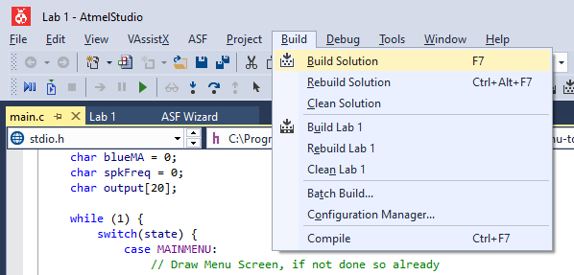
Checking your Code
Use the Build function (F7) in ATMEL studio to check for simple errors:
Syntax Errors
Undeclared Variables / Variables not in scope
Incorrect use of functions

Slide 2
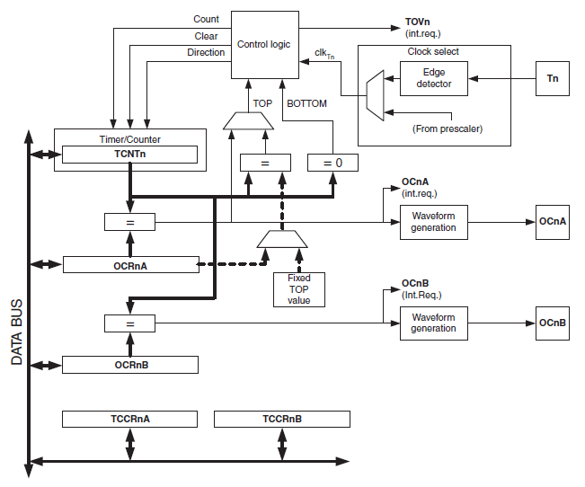
Timers
Clock Select
  Based off f_{osc} (and Prescaler) or from external source (via Tn Pin)
Clock Logic
  This instructs the timer/counter what to do next
  Considers parameters from other inputs (clock pulse, TOP & BOTTOM values, setup registers)
Timer/Counter
  Register TCNTn
  Will either count up, down, or reset to TOP/BOTTOM value
Output Compare Registers
  OCRnA/OCRnB
  Control the outputs on OCnA/OCnB pins on the μC
  OCRnA can also influence the Control Logic
Microchip AT90USB1287 Datasheet

Slide 3
Timer Modes
There are four different modes
  Normal
  Clear Timer on Compare Match (CTC)
  Fast PWM
  Phase-Correct PWM
For this week, we will be able to use either Normal Mode or CTC
  CTC requires less of the μC’s resources
  Normal mode is more involved to operate (but can be easier to understand)
Notes:
CTC:
Does not need an interrupt to operate
Can be more complicated to setup
Normal:
Requires an interrupt to set the correct cycle time

Slide 4
Modes - Normal
Timer counts up from 0 to 0xFF (25)
Events can be set on the timer to occur when the values in Output Compare Registers match
Four Compare Match Modes
  Normal
  Toggle
  Clear
  Set
255
TCNTn
Register Value
0
Pulses
Notes:
Normal Operation – The OCnA/B Pin is disconnected and the timer does not influence the output of that pin
Toggle – The OCnA/B Pin toggles it’s output between high and low on a compare match (plotted)
Clear – The OCnA/B Pin sets the output to low on a compare match
Set – The OCnA/B Pin sets the output to high on a compare match

Slide 5
Modes - Clear on Compare Match (CTC)
Timer counts up from 0 to the TOP value stored in OCRnA
When reached, the timer clears to 0, and an Interrupt is triggered (if enabled)
Four Compare Match Modes
  Normal
  Toggle
  Clear
  Set
255
TCNTn
OCRnA
Register Value
0
Pulses

Slide 6
Generating Square Wave Signals
255
OCRnA (CTC)
TCNTn (CTC)
Register Value
0
Pulses
255
OCRnA (Norm)
TCNTn (Norm)
Register Value
0
Pulses
Toggle on Compare Match
1
OCnA/B
0
Period
Pulses
Notes:
Notice how in Normal Mode we must constantly change the value of the OCRnA register – this requires an interrupt and will therefore take up a significant chunk of our resources!

Slide 7


Calculating Top Values for Frequencies
$$f_{PWM}= \frac{f_{osc}}{2 ×Prescaler ×(Top+1)}$$
$$Top= \frac{f_{osc}}{2 ×Prescaler ×f_{PWM}} −1$$
Notes:
Formulae Useful in Later Weeks – But shows how the prescalers & values were determined in this weeks example code

Slide 8
Example – Speaker Sound Generator
Let’s suppose we want to drive a speaker:
Have a variable frequency from 1kHz to 20kHz
Speaker is connected to PB4 (OC2A)
Uses the Timer to generate the frequency w/o code execution
What registers will we need to consider?
Timer 2 (connected to Speaker)
  TCCR2A
  TCCR2B
  TIMSK2

Slide 9
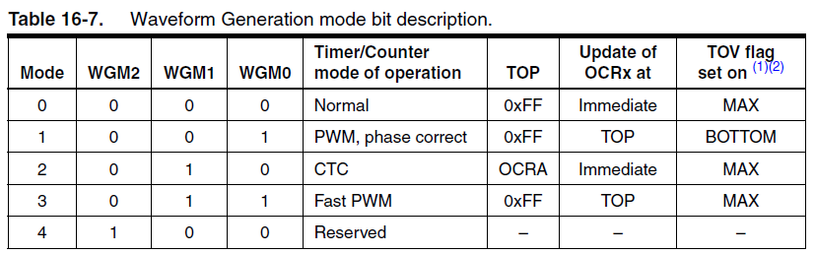
Example – Speaker Sound Generator
These are some of the available modes
  These will affect the timer frequency, and therefore the output PWM frequencies we can generate
There are two approaches – CTC and Normal Mode
  Both are included

Slide 10
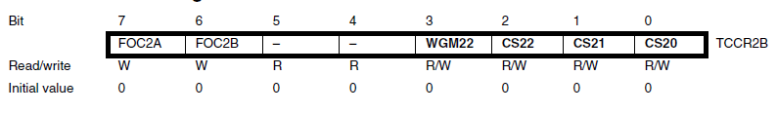
Example – Speaker Sound Generator (CTC)
Determine Register Values: TCCR2B
FOC2A/FOC2B – Force Output Compare A/B
  Not used
  Hence, set to 00
WGM22– Waveform Generation Mode
  We will be using CTC (even though it makes sense to use Fast PWM)
  Hence, set to 0
CS22 – CS20 – Clock Select
  Let us determine the necessary prescaler…

Slide 11
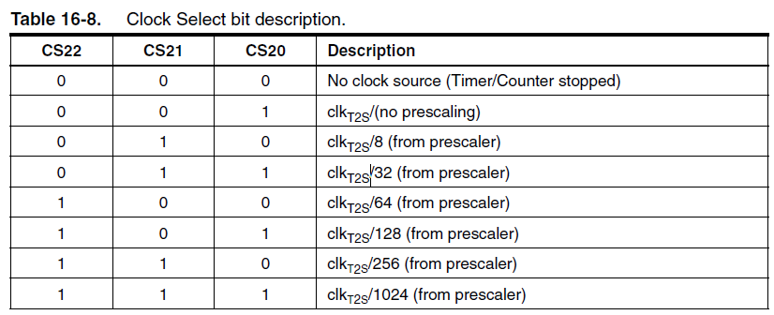
Example – Speaker Sound Generator (CTC)
These are the available prescalers
  These will affect the timer frequency, and therefore the output PWM frequencies we can generate
Note: Register Booklet contains the wrong table
  Use the table above for Timer 2

Slide 12
Example – Speaker Sound Generator (CTC)
What should we set the Prescaler to? Let us use trial & error to calculate a value.
$$f_{PWM}= \frac{f_{osc}}{2 ×Prescaler ×(Top+1)} → f_{PWM}= \frac{4 × {10}^{6}}{Prescaler ×(Top+1)}$$
Firstly, try with Prescaler = 1 – Find the TOP Value @ f_{pwm(min)} = 1 kHz:
$1000= \frac{4 × {10}^{6}}{1 ×(Top+1)}$ $→ Top=3999 → \text{∴ }\text{Prescaler}\text{ ≠ 1}$
Now, try with Prescaler = 8 – Find the TOP Value @ f_{pwm(min)} = 1 kHz:
$1000= \frac{4 × {10}^{6}}{8 ×(Top+1)}$ $→ Top=499 → \text{∴ }\text{Prescaler}\text{ ≠ 8}$
Now, try with Prescaler = 32 – Find the TOP Value @ f_{pwm(min)} = 1 kHz:
$1000= \frac{4 × {10}^{6}}{8 ×(Top+1)}$ $→ Top=124 → \text{∴ }\text{Prescaler}\text{ = 32}$
Prescaler is 32
Notes:
The formula has been simplified by substituting the fosc.
Notice that in the formula, there is an inverse relationship between the frequency and the TOP value (for a higher frequency, the TOP value is lower). Therefore, we can target calculating the lower frequency to save time.
The goal is to find a prescaler that has a TOP value less than 256. Otherwise, the 8-bit timer will not have sufficient resolution to meet the lower frequency.

Slide 13
Example – Speaker Sound Generator (CTC)
Determine Register Values: TCCR2B
// Define the value of TCCR2B
TCCR2B = 0b00000011;
FOC2A/FOC2B – Force Output Compare A/B
  Not used
  Hence, set to 00
WGM22– Waveform Generation Mode
  We will be using CTC (even though it makes sense to use Fast PWM)
  Hence, set to 0
CS22 – CS20 – Clock Select
  Prescaler of 32
  Hence, set to 011

Slide 14
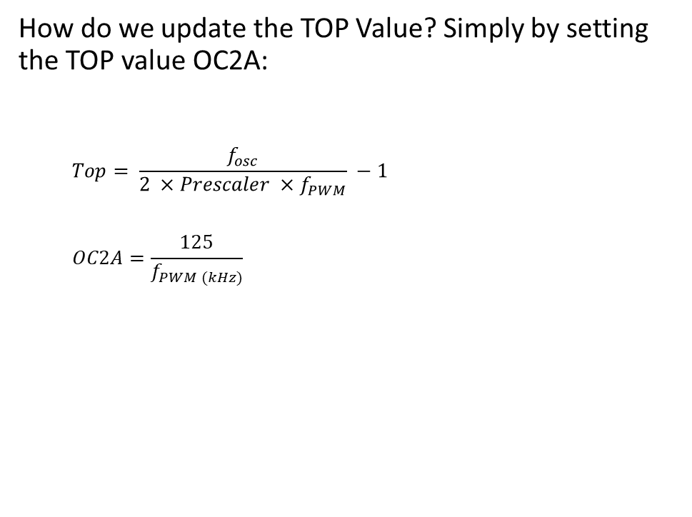
Example – Speaker Sound Generator (CTC)
How do we update the TOP Value? Simply by setting the TOP value OC2A:
  $$Top= \frac{f_{osc}}{2 ×Prescaler ×f_{PWM}} −1$$
  $$OC2A=\frac{125}{f_{PWM (kHz)}}$$
// Update the CTC value for the desired frequency
OC2A = 125 / freqInKHZ;

Slide 15
Example – Speaker Sound Generator (Normal)
Determine Register Values: TCCR2B
// Define the value of TCCR2B
TCCR2B = 0b00000011;
FOC2A/FOC2B – Force Output Compare A/B
  Not used
  Hence, set to 00
WGM22– Waveform Generation Mode
  We will be using CTC (even though it makes sense to use Fast PWM)
  Hence, set to 0
CS22 – CS20 – Clock Select
  Prescaler of 32
  Hence, set to 011

Slide 16
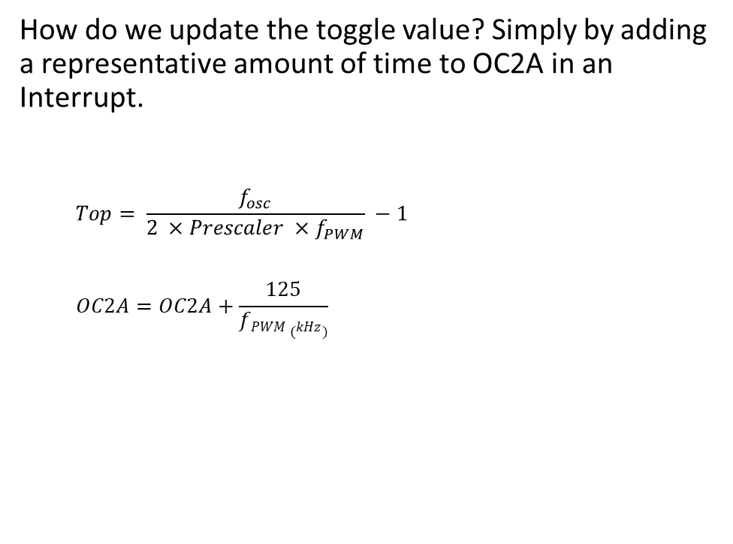
Example – Speaker Sound Generator (Normal)
How do we update the toggle value? Simply by adding a representative amount of time to OC2A in an Interrupt.
  $$Top= \frac{f_{osc}}{2 ×Prescaler ×f_{PWM}} −1$$
  $$OC2A=OC2A+\frac{125}{fPWM (kHz)}$$
// Update the CTC value for the desired frequency – Call this in the interrupt
OCR2A = OCR2A + 125/freqInKHZ;

